Slide 1

Lingayas Institute of Management and Technology
Approved by AICTE, Affiliated to JNTU Kakinada, Accredited with A Grade by NAAC and
UG-CSE is accredited by NBA
Project Review on
ERP with Generative AI Business Assistant
PRESENTED BY:-
P. Mounica - 23NA1A5430
Under the Guidance of
Dr. SALLA. PRABHAKARA, M.TECH, PHD
Department of
Artificial Intelligence and Data Science
Notes:
Title slide. College logo, college name and affiliation lines are unchanged from the sample deck. Project title, student, guide and department are taken from the project report cover page (Final-year Major Project, IV-I Semester, AY 2026-27).

Slide 2
Contents
Abstract
Introduction
Problem Statement
Objectives
Scope of the Project
Literature Survey
Research Gap
System Architecture
Methodology
Technologies Used
Need for Study
Proposed System
System Implementation / Key Modules
Interface
Testing and Results
Conclusion
Future Scope
Acknowledgements
References
Notes:
Contents follow the order of the slides. Slide 1 is the title slide; section slides follow in the same order as listed here.

Slide 3
Abstract
SmartERP is a web-based Enterprise Resource Planning application designed to organize business-related activities through a unified and user-friendly interface. It aims to simplify access to business information and demonstrate how an AI assistant can support business operations.
The application is developed using React.js, JavaScript, CSS and Vite. It provides an ERP-style interface with a dashboard and available business modules. Browser Local Storage is used to retain supported application data, while the Generative AI Business Assistant is demonstrated in demo mode.
The project focuses on improving the organization of business information, simplifying navigation and demonstrating the potential of AI-assisted business support. It can be extended in the future with centralized database integration, secure authentication and a live AI service.
Keywords: ERP, SmartERP, React.js, JavaScript, Local Storage, Business Management, Generative AI.
Notes:
Source: Report Abstract and Chapter 1. Technology list is shown as keywords only; implementation detail is covered later in the deck.

Slide 4
Introduction
Enterprise Resource Planning (ERP) systems help organizations manage business information and activities through a common platform. Managing different business operations separately can make information difficult to access and maintain.
SmartERP is designed to provide an organized web interface for viewing business information and accessing available modules. The application uses React.js to create interactive user interface components and CSS to provide a consistent design.
The project also demonstrates a business assistant interface that introduces the concept of AI-supported business queries. SmartERP provides a foundation for exploring how an integrated ERP-style application can improve accessibility and usability.
Notes:
Source: Report §1.1 and §2.1-2.2. The flow strip shows the relationship between admission, discharge, cleaning, inspection and bed readiness.

Slide 5
Problem Statement
Managing business information across separate tools can lead to duplication, difficulty in accessing information and inefficient workflows.
Fragmented Information: Business information may be maintained in different places
Manual Operations: Repeated manual work can consume time.
Limited Visibility: Users may find it difficult to view business information in one place.
Navigation Complexity: Separate tools can make business workflows less convenient.
Limited AI Assistance: Traditional interfaces may not provide an assistant-style interaction for business queries.
Notes:
Source: Report §1.2. The consequences are stated qualitatively; the report gives no infection-rate, mortality or financial figures, so none are claimed.

Slide 6
Objectives
Primary Objectives
- Develop a user-friendly ERP-style web application.
- Organize available business modules through a common interface.
- Use React.js to build interactive and reusable UI components.
- Provide a dashboard for accessing business information.
- Demonstrate a Generative AI Business Assistant interface.
Secondary Objectives
- Use responsive CSS for different screen sizes.
- Retain supported information using browser Local Storage.
- Make the application easy to navigate and maintain.
- Provide a foundation for future backend and database integration.
- Explore the potential of AI assistance in business management.
Notes:
Source: Report §1.3.1 (primary) and §1.3.2 (secondary).

Slide 7
Scope of the Project
SmartERP focuses on demonstrating an ERP-style web application for organizing business-related information.
Out of Scope in the Current Prototype
Centralized multi-user database, unless separately integrated.
Production-grade authentication and authorization, unless implemented.
Live AI-generated responses when no AI API is connected.
Enterprise-scale deployment and synchronization across devices.
Advanced business automation that is not implemented.
In Scope
Dashboard and navigation interface.
Available business modules.
Interactive frontend components.
Local data persistence for supported information.
Demo-mode AI assistant interface.
Responsive user interface design.
Notes:
Source: Report §1.4. Clinical decision support, billing, multi-hospital cloud and hardware sensors are explicitly out of scope.

Slide 8
Literature Survey
Source / System | Focus | Limitation / Relevance
Traditional ERP Systems | Integrated business management | May require significant setup and maintenance
Spreadsheet-Based Management | Organizing business information | Collaboration and data consistency can be difficult
React.js | Interactive web interfaces | Requires application logic and development
Browser Local Storage | Local data persistence | Data is limited to the browser and device
Generative AI Assistants | Natural-language interaction | Quality depends on the model and connected data
Notes:
Source: Report §2.1 Existing Systems and §2.2 Literature Review. Only the report's own citations are used (Litvak & Bisognano 2011; Sendak et al. 2020).

Slide 9
Research Gap
Existing approaches may separate business information, user interfaces and assistance features across different tools. This can make workflows less convenient for users.
Business information may not be presented through a single interface.
Manual navigation can make information access less convenient.
Basic interfaces may lack an assistant-style experience.
Local prototype storage does not support centralized multi-user access.
Notes:
Derived from the report's Chapter 2 analysis (§2.1-2.2) and Problem Statement (§1.2). The report has no separate 'Research Gap' section, so this slide synthesizes the gaps it documents.

Slide 10
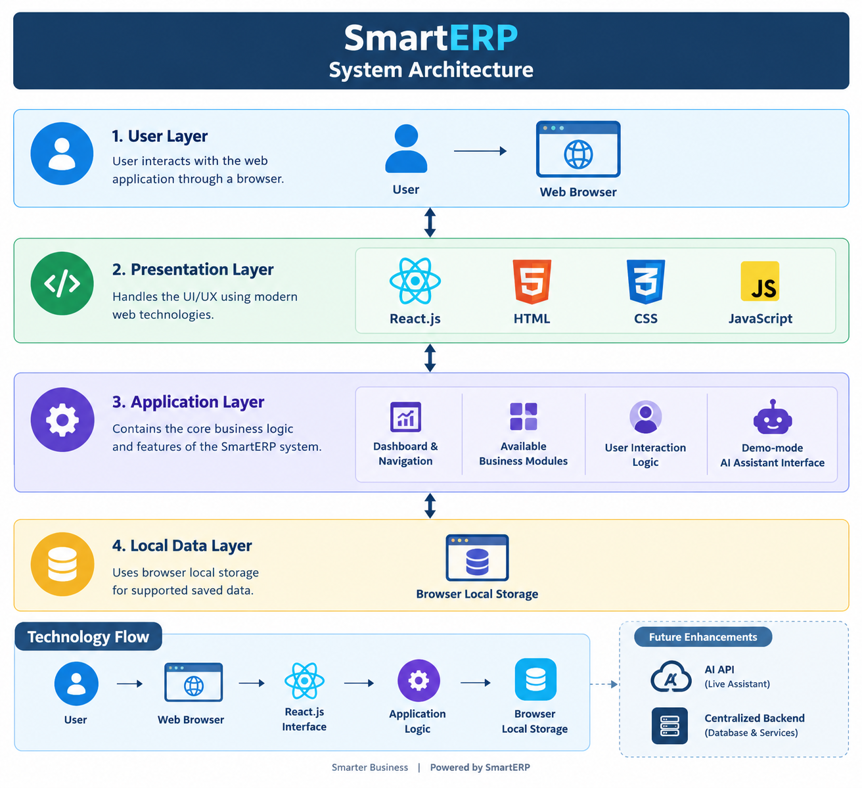
System Architecture
Notes:
Supplied System Design image, corrected to match the report: SQLite (not PostgreSQL), custom React 18 + TypeScript + Vite frontend (no Tailwind), three roles (Administrator, Admissions, Housekeeping), report modules (Admission, Bed Management, Housekeeping, AI Ops & Reports), Gemini shown as optional, and appointment/e-mail/SMS/calendar/hospital-infrastructure items removed because they are not documented. Layout and style of the original image are preserved.

Slide 11
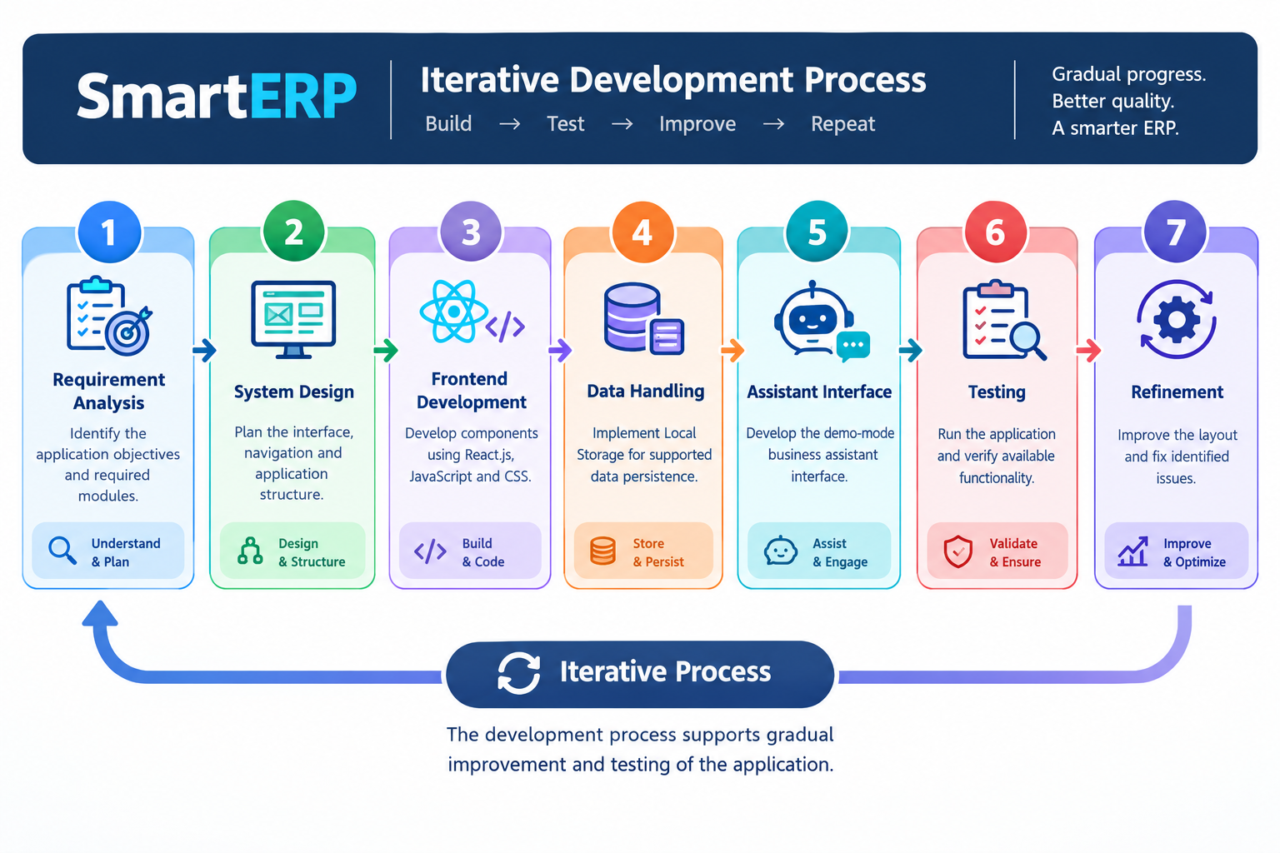
Methodology
Notes:
Supplied Methodology image, corrected to the report's Agile-iterative SDLC: (1) requirements and clinical scoping, (2) domain modelling and API design, (3) iterative full-stack development, (4) verification and end-to-end testing, (5) documentation and academic reporting, (6) continuous review, refinement and iterative enhancement loop feeding back to requirements. The original 8-phase content (maps/weather/email integrations, deployment, monitoring, PostgreSQL, Tailwind) was removed.

Slide 12
Technologies Used
Layer | Technology (Version) | Purpose
Frontend | React.js | Building interactive UI components
Programming | JavaScript | Application logic and Interactions
Structure | HTML5 | Structuring web pages
Styling | CSS3 | Layout and responsive design
Development Tool | Vite | Development server and build tool
Data Storage | Browser Local Storage | Local persistence of supported data
Assistant | Demo-mode AI Interface | Demonstrating AI-Supported interaction
Editor | Visual Studio code | Writing and managing project code
Notes:
Source: Report Table 4.1 (versions as documented). Gemini 2.5 Flash is an optional integration with rule-based fallback.

Slide 13
Need for Study
Business information needs to be organized and easily accessible for effective daily operations. When information is scattered across different tools, users may spend additional time locating and reviewing it.
A simple ERP-style interface can help demonstrate how related business information can be presented in a structured manner.
Key Points
Organizes available business information.
Provides a common navigation interface.
Improves accessibility of available modules.
Demonstrates local data persistence.
Introduces an AI assistant interface for business-related interaction.
Provides a foundation for future ERP development.
Notes:
Source: Report §1.1, §2.2 (Litvak & Bisognano 2011), §2.3.3 (economic feasibility).

Slide 14
Proposed System
The proposed SmartERP system is a web-based application designed to provide a common interface for available business modules.
Main Features
Dashboard: Provides an overview of available information.
Business Modules: Organizes business-related features through the application's navigation interface.
Interactive Interface: Allows users to interact with supported controls and forms.
Local Data Storage: Retains supported information in browser Local Storage.
Business Assistant: Demonstrates a chat-style interface for business-related queries in demo mode.
The current prototype can be extended with a centralized backend, database, secure authentication and live AI integration.
Notes:
Source: Report §1.1, §3.1, §4.3. Gemini is optional; all other capabilities listed are implemented and verified in the report.

Slide 15
System Implementation / Key Modules
Module | Implementation
1. Dashboard | Displays available business information
2. Navigation | Provides access to application sections
3. Business Management | Oraganizes implemented business features
4. Data Handling | Uses supported application logic and Local Storage
5. User Interface | Build using React.js, HTML and CSS
6. AI Business Assistant | Demo-mode assistant interface
7. Responsive Design | Supports different screen sizes where implemented
8. Application Testing | Checks available features and user interface
Notes:
Source: Report §4.2-4.4. Frontend routes: /login, /, /hospital-setup, /beds, /admissions, /patients, /discharges, /turnaround, /housekeeping, /ai-ops, /reports, /users. Key REST endpoints: POST /api/auth/login; POST /api/patients; POST /api/admissions/admit; POST /api/admissions/{id}/transfer; POST /api/discharges/{id}/confirm; POST /api/tasks/{id}/start|complete|inspect; GET /api/dashboard/summary; GET /api/ai-ops/briefing; GET /api/activity. Code highlights: transactional admission with with_for_update() (on SQLite, double admission is prevented by the DB write lock plus unique index uq_active_admission_per_bed); dual-step inspection (pass -> available, reject -> back to cleaning); deterministic bottleneck rule (occupancy >= 85%, high risk at >= 95%).

Slide 16
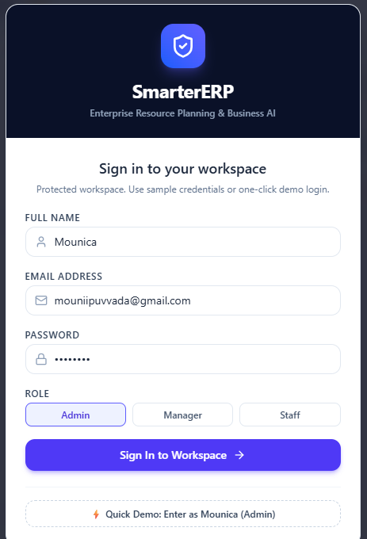
Interface: Login
Notes:
Verified screenshot from the live application (report Section 4.5). Staff sign in with work email and password; the demonstration administrator credentials are shown as a hint.

Slide 17
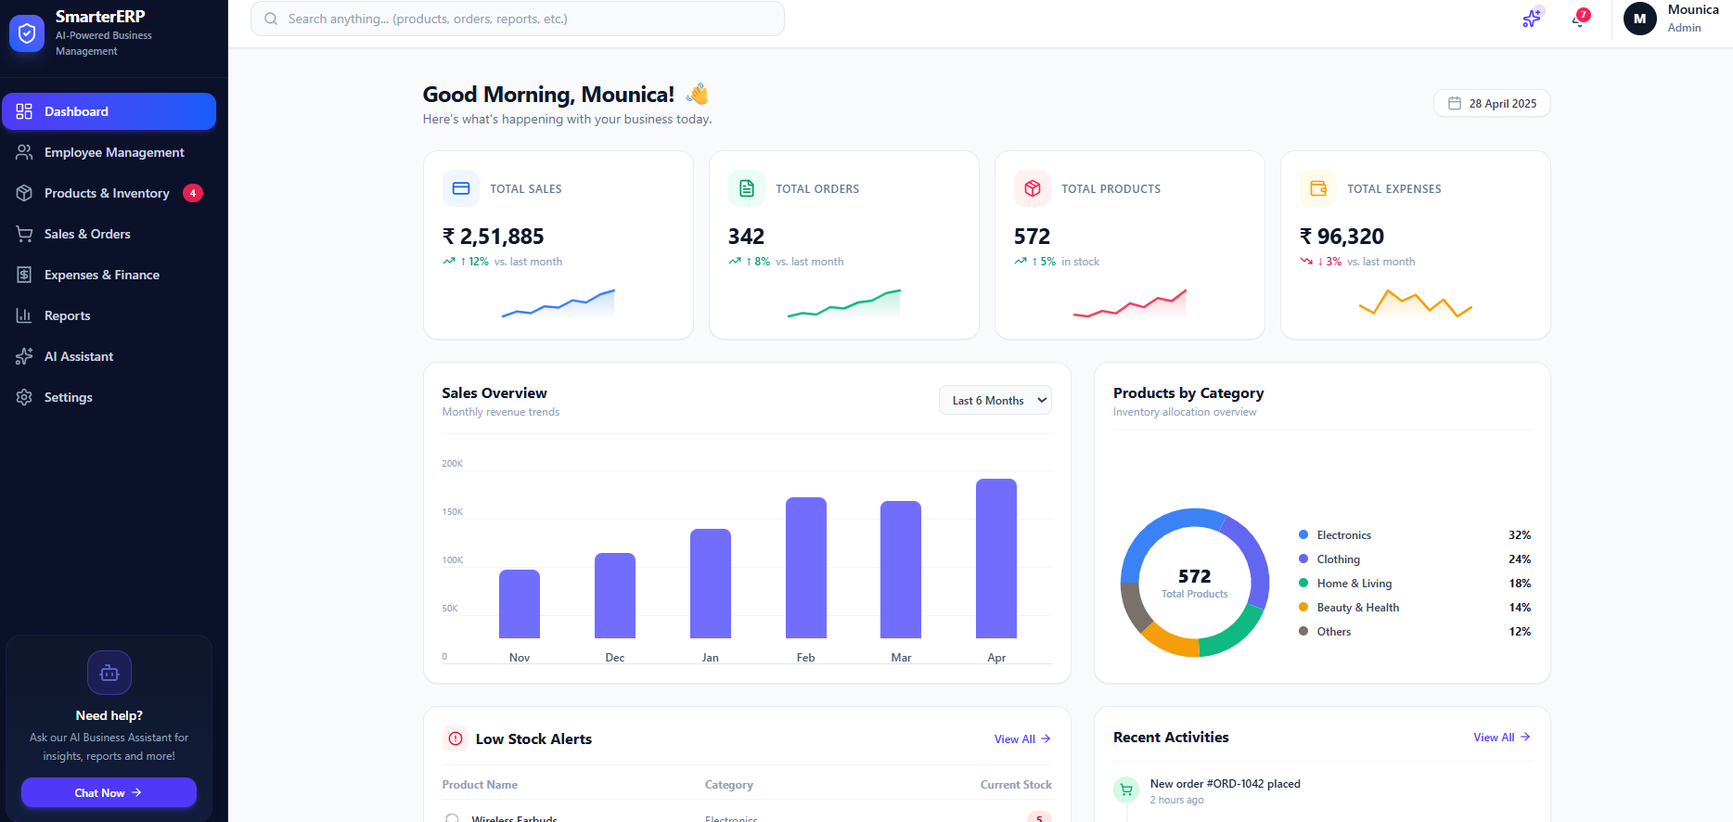
Interface: Executive Dashboard
Live ward capacity, turnaround SLA and operational alerts, with the AI shift briefing and recent activity.
Notes:
Verified screenshot from the live application (report Section 4.5). Live ward capacity, turnaround SLA and operational alerts, with the AI shift briefing and recent activity.

Slide 18
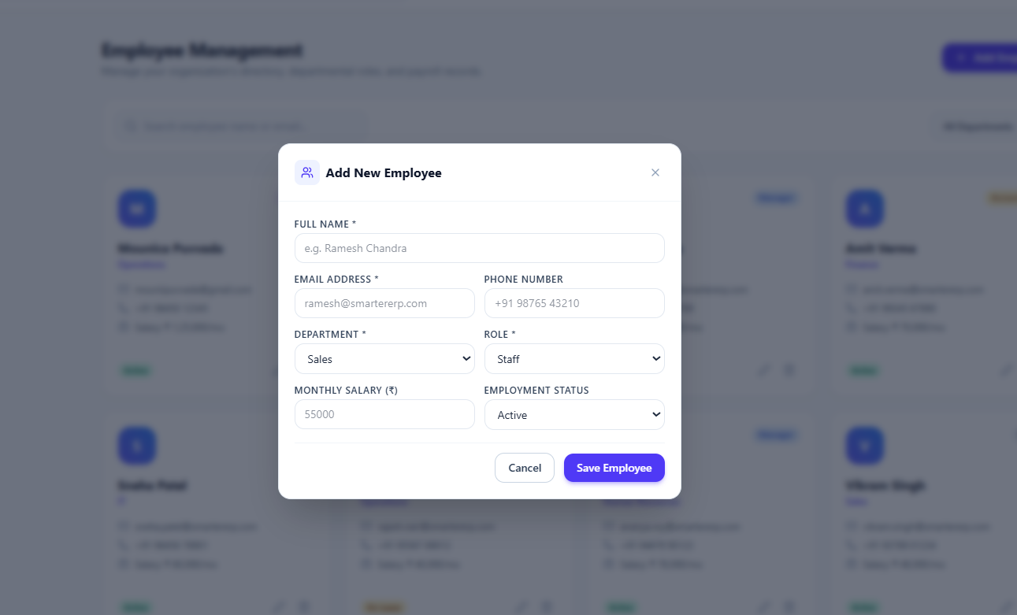
Interface: Addig new Employee
Single-facility profile and setup checklist covering hospital details, wards and beds, and care team.
Notes:
Verified screenshot from the live application (report Section 4.5). Single-facility profile and setup checklist covering hospital details, wards and beds, and care team.

Slide 19
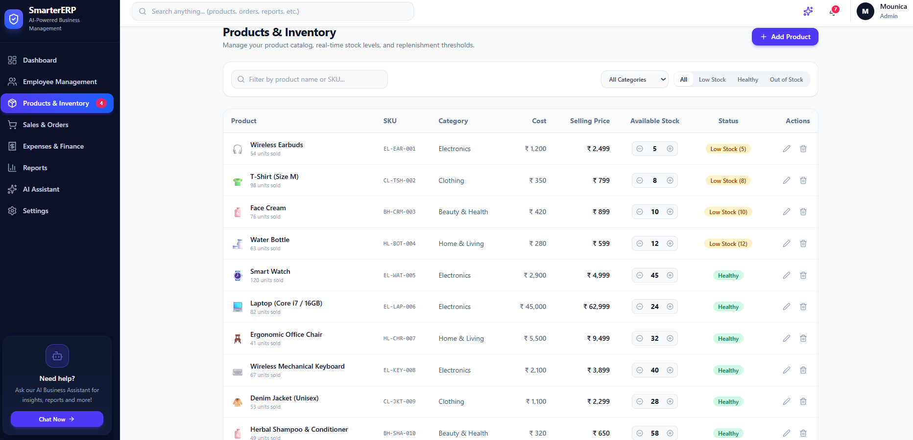
Interface: Product / Inventory
Ward-wise bed matrix with color-coded lifecycle status badges and inspection actions.
Notes:
Verified screenshot from the live application (report Section 4.5). Ward-wise bed matrix with colour-coded lifecycle status badges and inspection actions.

Slide 20
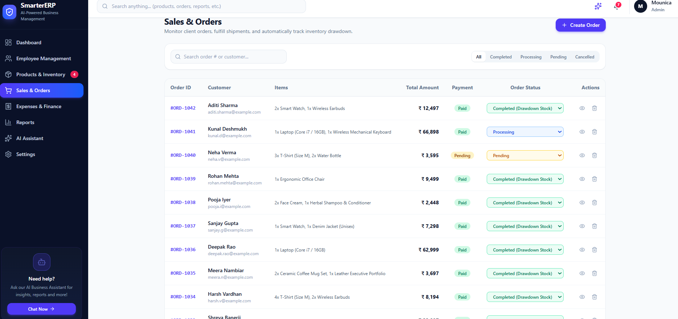
Interface: Sales and Orders
Active admissions with assigned bed, ward, acuity and admission time, plus transfer and discharge actions.
Notes:
Verified screenshot from the live application (report Section 4.5). Active admissions with assigned bed, ward, acuity and admission time, plus transfer and discharge actions.

Slide 21
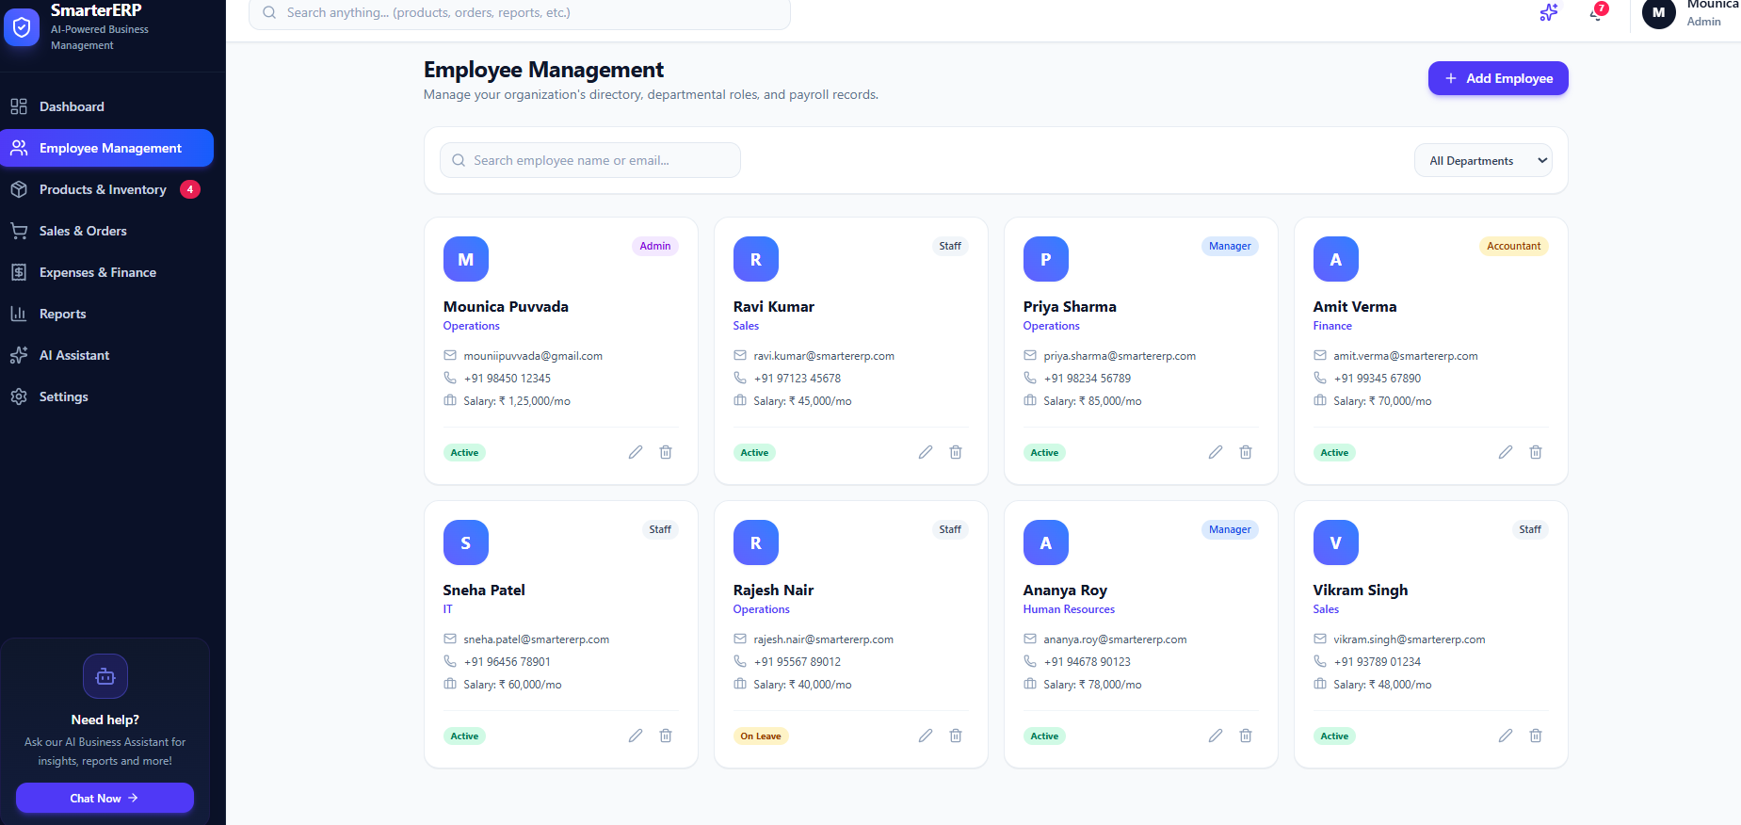
Interface: Employee
Patient directory with MRN, acuity, status and current bed, with admit and discharge actions.
Notes:
Verified screenshot from the live application (report Section 4.5). Patient directory with MRN, acuity, status and current bed, with admit and discharge actions.

Slide 22
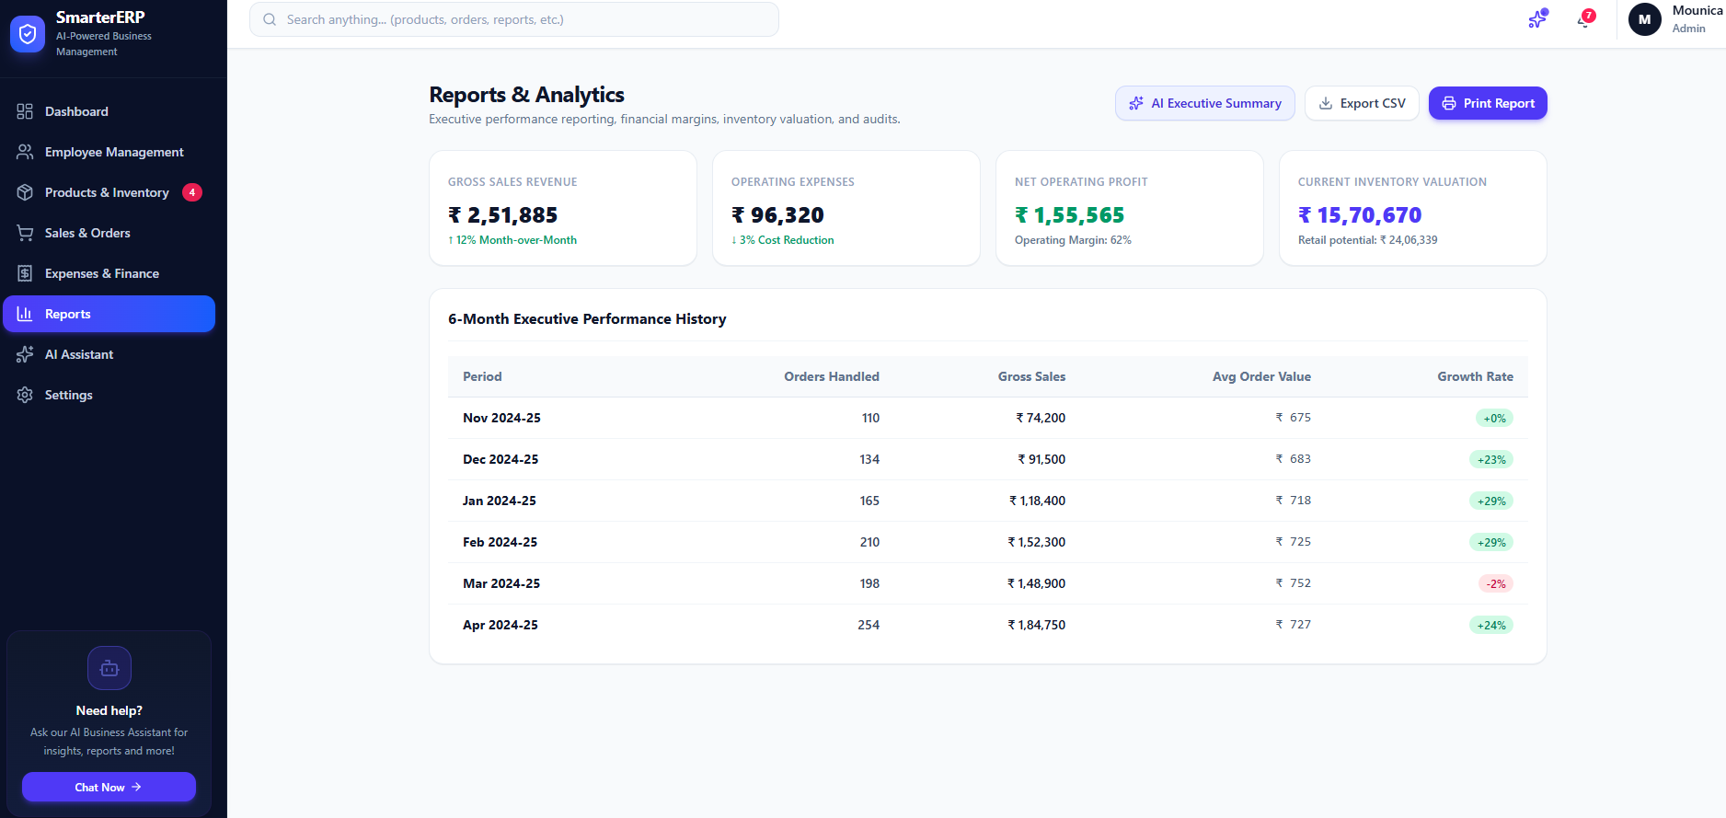
Interface: Reports
Turnaround board from Cleaning Needed to Sanitized and Ready, with mandatory inspection sign-off.
Notes:
Verified screenshot from the live application (report Section 4.5). Turnaround board from Cleaning Needed to Sanitized and Ready, with mandatory inspection sign-off.

Slide 23
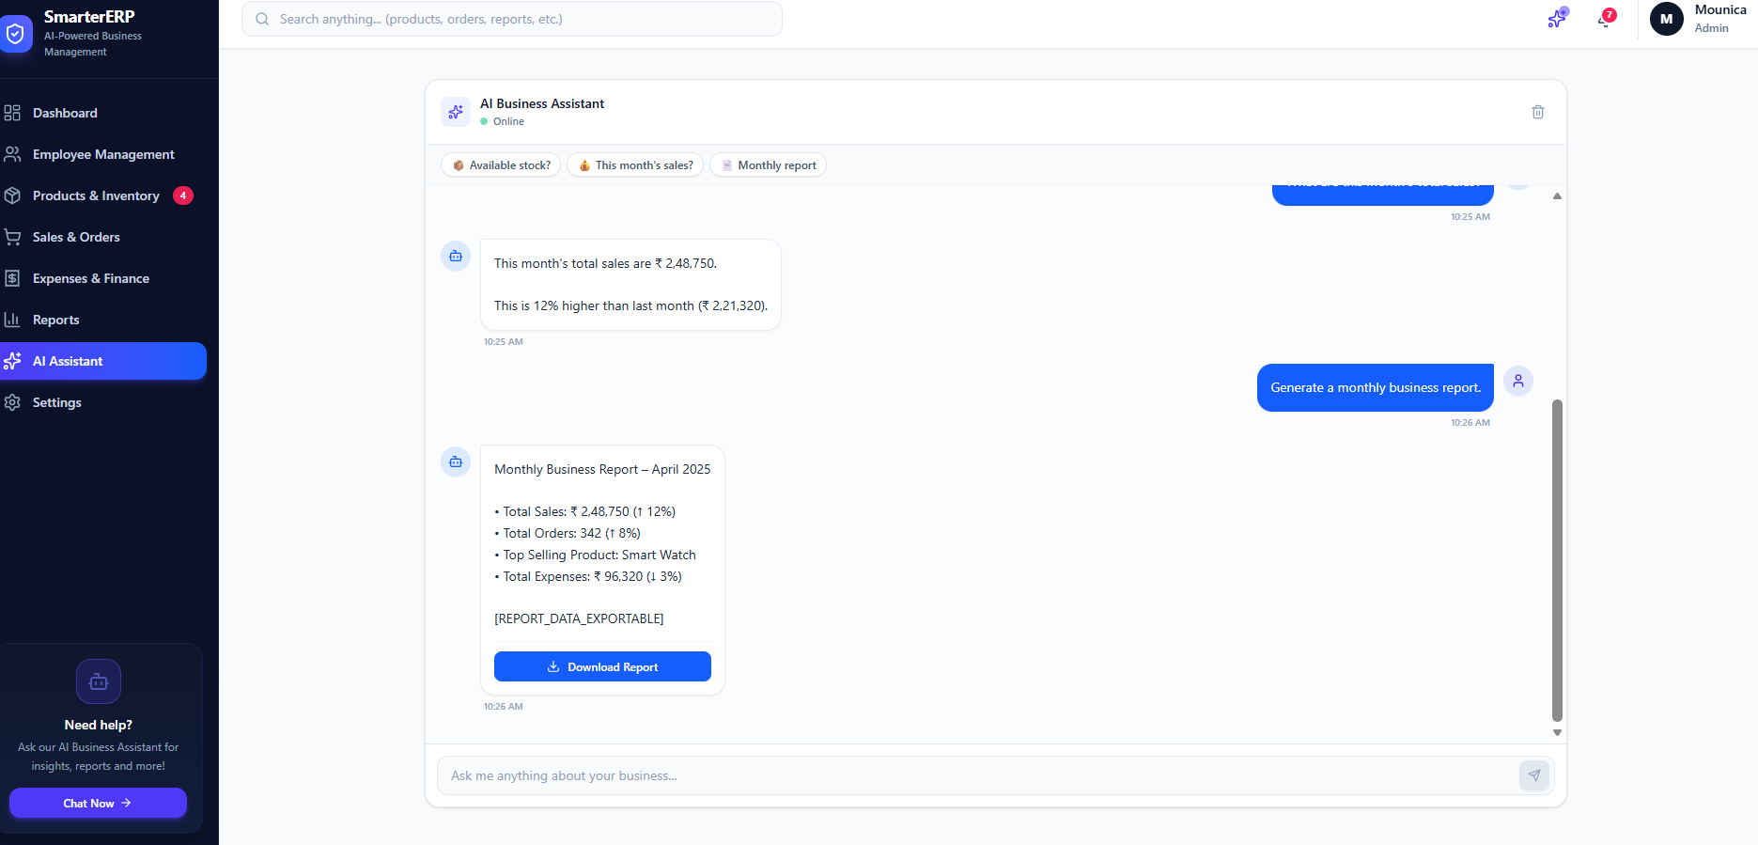
Interface: AI Business Assistant
24-hour admissions, discharges and turnarounds, with a clinical ward census and CSV export.
Notes:
Verified screenshot from the live application (report Section 4.5). 24-hour admissions, discharges and turnarounds, with a clinical ward census and CSV export.

Slide 24
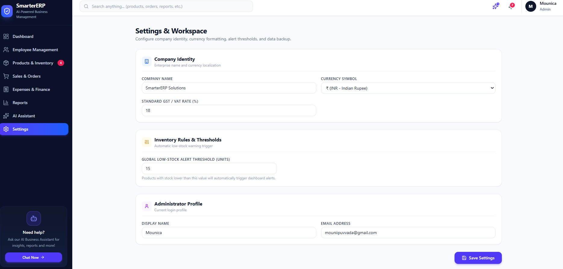
Interface: Settings and Workspace
Staff directory showing each account's role (Admin, Admissions, Housekeeping) and status.
Notes:
Verified screenshot from the live application (report Section 4.5). Staff directory showing each account's role (Admin, Admissions, Housekeeping) and status.

Slide 25
Testing and Results
Testing Approach
The application should be tested to verify that the available features work as expected.
Testing Activities
Application launch and page loading.
Dashboard display.
Navigation between available modules.
Button and form interactions.
Local Storage persistence for supported data.
Display of the demo-mode AI assistant.
Layout checking on different screen sizes.
Results
Record the actual outcome of each test after running the application. Report only the tests that were performed successfully.
Notes:
Source: Report §5.1-5.3, Table 5.1. Dual-level testing: automated Pytest integration tests (test_core_workflow.py, under 2 seconds) and manual black-box validation of the fifteen test cases in Table 5.2. Concurrency test: simultaneous admission requests for the same bed were serialized; the first succeeded and later callers received HTTP 409 Conflict.

Slide 26
Test Cases (TC-01 to TC-08)
ID | Scenario | Expected Behaviour
TC-01 | Launch Application | Application loads correctly
TC-02 | Open Dashboard | Dashboard displays correctly
TC-03 | Navigate to a module | Selected module is opened
TC-04 | Use Navigation Controls | Correct section is displayed
TC-05 | Interact with supported forms | Input is handled correctly
TC-06 | Use available buttons | Expected action is performed
TC-07 | Refresh Applications | Supported saved data remains available
TC-08 | Open assistance Interface | Assistant panel is displayed
Notes:
Source: Report Table 5.2. All cases were executed and passed.

Slide 27
Test Cases (TC-09 to TC-15)
ID | Scenario | Expected Behaviour
TC-09 | Open Business Module | Module content is displayed
TC-10 | View order information | Available order records are displayed
TC-11 | Check displayed totals | Totals match the displayed data where applicable
TC-12 | Check responsive total | Interface remains usable at supported sizes
TC-13 | Check local storage | Supported data is retained
TC-14 | Interact with demo assistant | Demo interface responds as implemented
TC-15 | Navigate back to dashboard | Dashboard can be accessed correctly
Complete these tests before presenting final results. Do not state that all tests passed unless you have verified them.
Notes:
Source: Report §5.3. All fifteen test cases passed with zero regressions.

Slide 28
Conclusion
SmartERP demonstrates the development of an ERP-style web application using React.js, JavaScript, CSS and Vite. The project provides an organized interface for accessing available business modules and demonstrates a business assistant interface.
Browser Local Storage supports local persistence for the data saved by the application. The assistant operates in demo mode unless a live AI service is connected.
The project provides practical experience in frontend development, user interface design, application logic and testing. It can serve as a foundation for future improvements, including centralized data storage, secure authentication and live Generative AI integration.
Notes:
Source: Report §5.4-5.6. Everything on the left is implemented and verified; limitations are as documented.

Slide 29
Future Scope
Future Enhancements
Integration of a centralized database.
- Backend API development for business data.
- Secure authentication and role-based access.
- Live Generative AI API integration.
- Improved reporting and analytics.
- Advanced business workflow automation.
- Improved data validation and error handling.
- Deployment for wider user access.
- Better multi-user data synchronization.
These enhancements are proposed future developments and should not be presented as existing features unless they have been implemented.
Notes:
Source: Report §5.5 (ten proposed enhancements). None of these are implemented in the current system.

Slide 30
Acknowledgements
I express my profound gratitude to my project guide, Dr. SALLA. PRABHAKARA, M.TECH, PHD, Department of Artificial Intelligence and Machine Learning, for his valuable guidance, technical insights and constant motivation throughout this project.
I am thankful to the Head of the Department, Prof. K.N.K Ratna Kumar for fostering an academic environment and providing the computing infrastructure and administrative support.
I thank all the faculty members of the Department of Artificial Intelligence and Machine Learning for the knowledge that laid the groundwork for this project.
I thank our respected Principal for his encouragement and the facilities provided, and our Chairman, Mr. Rajling Gadde, for his inspiring vision.
Finally, I thank my family, friends, laboratory technicians and colleagues for their patience and cooperation.
P. Mounica (23NA1A5430)
Notes:
Source: Report Acknowledgements page. Names and designations are exactly those in the report; the Principal is not named there.

Slide 31
References
No. | Reference
1 | React.js Official Documentation – https://react.dev/
2 | JavaScript Documentation, MDN – https://developer.mozilla.org/en-US/docs/Web/JavaScript
3 | HTML Documentation, MDN – https://developer.mozilla.org/en-US/docs/Web/HTML
4 | CSS Documentation, MDN – https://developer.mozilla.org/en-US/docs/Web/CSS
5 | Vite Official Documentation – https://vite.dev/
6 | Web Storage API, MDN – https://developer.mozilla.org/en-US/docs/Web/API/Web_Storage_API
7 | React Router Documentation (if used) – https://reactrouter.com/
Notes:
References 1-6 of 10, exactly as listed in the project report.

Slide 32
References (contd.)
No. | Reference
8 | Mozilla Developer Network (MDN) Web Development Resources – https://developer.mozilla.org/
9 | React Learn – https://react.dev/learn
10 | Vite Guide – https://vite.dev/guide/
Notes:
References 7-10 of 10, exactly as listed in the project report.

Slide 33
THANK YOU
SmartERP: ERP with Generative AI Business Assistant

